Slide 1

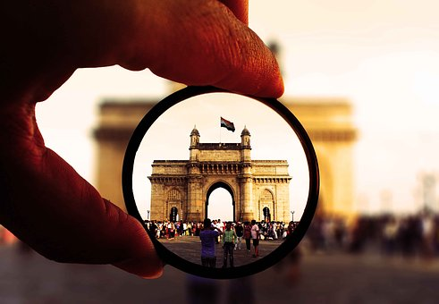
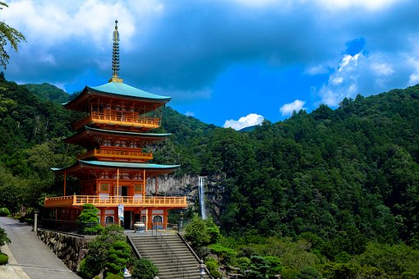

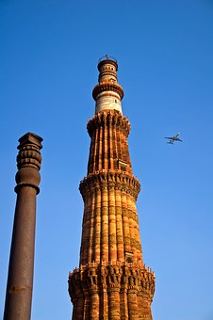
TCSへようこそ！ Welcome to TCS
Notes:
1
1

Slide 2
Customer Executives
muRata Japan:
Mr. Yasuhiro Uehara - Sr. Manager , IT Strategy Planning Section
muRata Singapore:
Mr. Jun Tuchisaka - General Manager , Regional Business Engineering
Mr. Takashi Shimomukai - Manager, Business Engineering
Mr. Daichi Kawai - Manager, Strategic Planning
muRata India:
Mr. Rajesh Gopalakrishna - Asst General Manager, Product Marketing Head
TCS Team
Bangalore
Mr. Laxmikant Shaligram –Deputy Head, JDC
Mr. Anantha Shastry – Industry Leader, Hi-Tech BU
Mr. K Eswarmoorthy – Industry Leader, IoT DE
Mr. Shivaji Hogale – Industry Leader, IoT DE
Mr. Srikanth MKG – Delivery Manager, JDC
Mr. Balaji Ramanathan – Business Relationship Manager, JDC
Notes:
2

Slide 3
AGENDA
22nd Oct 2024 (Tuesday) – Anchor, Bhandhani, (15 S)
Start Time | Duration (hr) | End Time | Agenda | Presenter (s)/ Stories | Location
9:15 AM | 0:15 | 09:30 AM | Entry Formalities | All | Anchor Building Reception/Gate
09:30 AM | 0:30 | 10:00 AM | JDC Overview and DX cases | Shali | Bhandhani (15 S)
10:00 AM | 0:30 | 10:30 AM | AI, Gen AI and TICO TARO | Pranjal/Nandha (Teams) | Bhandhani (15 S)
10:30 AM | 0:15 | 10:45 AM | SAP in Tech SS | Ravi (Teams) | Bhandhani (15 S)
10:45 AM | 0:15 | 11:00 AM | Hi-tech in Japan | Anantha (Teams) | Bhandhani (15 S)
11:00 AM | 0:30 | 11:30 PM | ServiceNow/SalesForce | Amit/Vijay (Teams) | Bhandhani (15 S)
11:30 AM | 0:30 | 12:00 AM | IoT Lab visit | Eswar/Shivaji | Anchor, 1st Floor
12:00 PM | 1:00 | 1:00 PM | Lunch and Wrap-up | All Members | EDR
Notes:
3

Slide 4


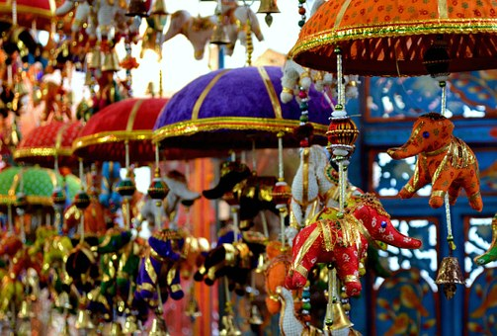
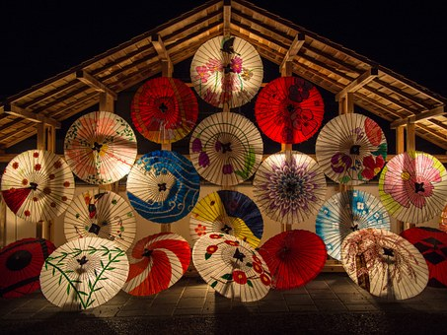


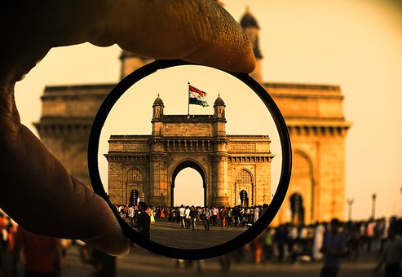
ありがとうございました

